Slide 1
Lecture 10: Software Defined Storage and Lecture 12 : OpenStack Swift
CSE491: Cloud Computing

Slide 2
Storage
Requirements of Storing unstructured data:
Durability
Availability
Manageability
Low cost
Three broad categories of data storage:
Block Storage
File Storage
Object storage

Slide 3
Object Storage
Object storage is designed to be a massive, scalable static data solution. In object storage every single unit of data exits at the same level in a storage pool. This unique design makes object storage more scalable, efficient and reliable than all other solutions for static data.
One way to manage Object storage is through Open IO SDS C API, which allows to create storage pools in pseudo containers.
It reduces operator burden.
An Object storage system provides a single namespace, there is no need to break data up and send it to different storage locations, which can increase complexity and confusion.

Slide 4
Object Storage
Data that benefits the most from object storage includes:
Unstructured data such as music, images, videos
Backup and log files
Large sets of historical data
Archived files
One of the main advantages of Object storage is its ability to distribute requests for objects across a large number of storage servers. It provides access to whole objects of data through an API specific to that system. Objects are accessible via URLs using HTTP protocols the same way how websites are accessible in web browsers.

Slide 5
Storage Virtualization
Storage virtualization pools data from multiple storage and presents those as centralized storage.
Multiple storage systems could be SAN, NAS or DAS. All these storage Pulled and put some logical front end on it and represents it as a single centralized storage which is Storage virtualization. It allows the capacity of many storage devices to be pooled and it looks as if all the storage is from one single device.
Storage virtualization, the ability to abstract physical storage from the control plane, is a necessary but not sufficient capability for SDS.
Through the technology of Storage virtualization and SDS one can utilize ones storage system more efficiently.

Slide 6
Open Source Software
Open source software is a software with source code that anyone can inspect, modify and enhance.
LibreOffice and the GNU Image manipulation program are examples of open source software.
To use Open source software user must accept the terms of a license. Open source encourages a large thriving ecosystem, where the diversity of the community members drives standards and tools.
Software defined storage based on open source software and commodity hardware.
Open source based software defined storage solution’s address todays insurmountable data storage challenges at a reasonable budget and are already available.

Slide 7
SDS-Software Defined Storage
Best meet with the requirements of unstructured data storage – durability, availability, manageability and low cost.
Software defined storage provide the required amount of storage to the application. According to the workflow and process of the application it may increase or decrease its requirements of storage but SDS applies automation and policy through which it takes back the provisioned storage and provide it to another application.
SDS abstract the storage services, or storage software, and separates them from the device itself.
SDS system need to offer extensive policy based automation for resource provisioning and management as well as the ability to programmatically control storage via REST APIs.

Slide 8
SDS
SDS places responsibility for the system in the software.
It works through the failures.
It feeds data into a cloud.
It works within a cloud environment to provide unified storage.
It has networked access, management and automation software that allows to quickly scale and provide metered service.
Some Software defined storage vendors:
Nexenta
Nutanix
Scality

Slide 9
Software Defined Storage Environment
Flexible
Cost effective
High performance
Highly Available
Massive scalable
Which keeps up with the growth of the business required storage
Software Defined Storage reduces
Cost
Management overhead
Without compromising
Flexibility
Scalability
Reliability

Slide 10
History
For the larger applications storage needed to accommodate more than the architecture of an in-line-storage controller can accommodate.
Older generations of storage were
Custom hardware
Used closed software
Expensive maintenance contracts
Difficult data migration
Tightly controlled ecosystem
SDS solutions offer the best way to store unstructured data . It provides way to deal with failures. Because of SDS it is possible to run system on standard and open server hardware.
It serves as a single system over large-scale, private, corporate networks or even the Internet. This is a powerful defense against the deluge of data that many businesses are experiencing.

Slide 11
Software Defined Storage Components
Storage routing: It acts as a gateway to the storage system. Pools of routers and services to access the routers can be distributed across multiple data centers and geographical locations. The router layer scales out with each additional node and allows more capacity for data access. The routers in an SDS system can route storage requests around hardware and networking faults.
Storage Resilience: Various data protection schemes are used to ensure that data is not corrupted or loss. Various processes keeps running on the system to continuously audit the existing data and measures how well the data is being protected throughout the multiple storage nodes.

Slide 12
Software Defined Storage Components
Physical hardware: It stores bits on disk. Though, nodes storing data are not responsible for ensuring the durability of their own data, as that is the responsibility as of the storage resilience systems. The storage architecture of SDS separates the storage software from the hardware. SDS allows to remove the storage capacity from inflexible pieces of hardware and put it all in a place that’s infinitely flexible and scalable.
Out of band controller: SDS distributed storage systems need an alternative form of management which intercepts each storage request. This is an external storage controller which is used by operators to orchestrate members of a distributed SDS system.
A controller can dynamically tune the system for optimize performance, upgrades and manage capacity and allows faster recovery in case of hardware failing.
SDS controller can orchestrate available resources – storage, network, routing and services for the entire cluster.

Slide 13
Characteristics of Software Defined Storage
Commodity Hardware: All the intelligence in software defined storage is in the software layer. SDS systems use commodity, off-the-shelf hardware for both physical storage as well as the interconnecting fabric the storage network.
Scale-out Architecture: Hardware in a software-defined storage system needs to enable rather than hinder fluid, flexible and elastic configuration of storage resources through software. The best way to achieve this fluidity is by using a building-block approach to storage that allows architects to dynamically add and remove resources, in contrast to legacy storage with rigid controller designs.
Resource Pooling: The available storage resources are pooled into a unified logical entity that can be managed centrally. The control plane provides fine-grained visibility and control to all available resources in the system.

Slide 14
Characteristics of Software Defined Storage
Abstraction: Physical storage resources are virtualized and presented to the control plane, which can then configure and deliver them as tiered storage services.
Automation: The storage layer provides extensive automation that enables it to deliver one-click, policy based provisioning of storage. Administrators and users request storage resources in terms of application needs capacity, performance and reliability rather than storage configurations such as RAID levels or physical location of drives. The system automatically configures and delivers storage as needed on the fly. It also monitors and reconfigures storage as required to continue to meet SLAs.
Programmability: the storage system offers fine-grained visibility and control of underlying resources via rich APIs that allows administrators and third-party applications to integrate the control plane across storage, network and compute layers to deliver workflow automation. The real power of software-defined storage lies in the ability to integrate it with other layers of the infrastructure to build end-to-end application-focused automation.

Slide 15
Benefits of Software Defined Storage
Can choose the hardware that will run storage services. One cane choose SDS from different company from where one bought the hardware. One can maximize the capacity of existing hardware as storage needs to grow.
Its cost efficient. SDS is distributed and scales out instead of scaling up, allowing to adjust capacity and performance independently.
Capacity management system is simpler as each component is a member of a distributed system.
Upgrades, expansions and decommissions can be achieved without any downtime and with no need for forklift (physical) data migration.
SDS solutions are also often open source, which means better standards, more tools, and the ability to lock-in to a single vendor.
SDS is infinitely scalable.

Slide 16
Work of SDS
SDS is the most useful for its independence from any specific hardware.
SDS does not separate the storage itself from the hardware. SDS is merely a layer of technology stack which provides many services using industry standard servers instead of proprietary hardware.
SDS abstract the things that control storage requests. It does not abstract what is actually stored. It’s a software layer between the physical storage and the data request which allows to manipulate how and where data is stored.
SDS controller software provides storage access services, networking, and connectivity.
The most important characteristic of SDS controller software is that it makes no assumptions about the capacity or usefulness of the underlying hardware.

Slide 17
Ceph
Ceph is an open source software storage platform. It implements object storage on a single distributed computer cluster. The best choice for open source software defined storage is Ceph. Ceph is not dependent on any vendor specific Hardware.
It aims for :
Completely distributed operation without a single point of failure
Scalable to the Exabyte level
Freely available
Ceph is overwhelmingly preferred for storage by the users of Open Stack. This is the fastest growing and most popular Open Source project.

Slide 18
Ceph
Ceph provides industry leading storage functionality such as
Erasure coding for Space efficient, resilience and fault tolerance
Cache tearing for performance, optimize data placement
Unified block, file and object interface
Thin provisioning for capacity optimization
Ceph is a full-featured software-defined storage (SDS) solution. It’s very popular because of its robust design and scaling capabilities, and it has a thriving open source community. Ceph provides all data access methods and appeals to IT administrators with its unified storage approach.

Slide 19
Software Defined Storage (SDS): OpenStack Swift
Available Object Storages in Open source:
SWIFT
CEPH
JETS3T
SWIFT: Swift is a widely-used and popular object storage system provided under the Apache 2 open source license. Swift is designed to store files, videos, analytics data, web content, backups, images, virtual machine snapshots and other unstructured data at large scale with high availability and 12 nines of durability.

Slide 20
Along with SwiftStack, contributors include IBM, RedHat, HP, and Rackspace. Swift powers storage clouds at Comcast, Time Warner, Globo, and Wikipedia, as well as public clouds like Rackspace, NTT, OVH, and IBM SoftLayer...just to name a few.
"Swift…one of the more forward-looking projects…was built to be composable, meaning it was built to be used with or without other OpenStack components. So, a shout-out to the Swift team for thinking ahead…if [customers] just want object storage, they’re able to bring in Swift.”
- Mark Collier, Chief Operating Officer, OpenStack Foundation
CEPH: Ceph is an open-source software storage platform, implements object storage on a single distributed computer cluster, and provides 3-in-1 interfaces for object-, block- and file-level storage. Ceph aims primarily for completely distributed operation without a single point of failure, scalable to the Exabyte level, and freely available.
Ceph replicates data and makes it fault-tolerant, using commodity hardware and requiring no specific hardware support. As a result of its design, the system is both self-healing and self-managing, aiming to minimize administration time and other costs.

Slide 21
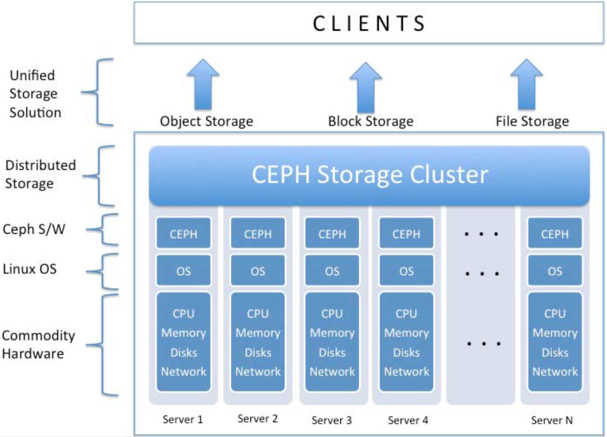

Slide 22
JETS3T: JetS3t is a free, open-source Java toolkit and application suite for Amazon Simple Storage Service (Amazon S3), Amazon CloudFront content delivery network, and Google Storage for Developers.
The JetS3t toolkit provides Java programmers with a powerful yet simple API for interacting with storage services and managing data stored there.
To use JetS3t you need an Amazon S3 and/or an Google Storage account to gain access to the cheap and plentiful storage space that makes these services so attractive.
There are also five applications included in the JetS3t suite. Applications for using your own online storage accounts:
(1) Cockpit (4) CockpitLite
(2) Synchronize (5) Uploader
(3) Gatekeeper

Slide 23
Swift Use Cases
Swift allows for a wide spectrum of uses, including supporting web/mobile applications, backups, and active archiving. Layers of additional services let users access the storage system via its native HTTP interface, or use command-line tools, filesystem gateways, or easy-to-use applications to store and sync data with their desktops, tablets, and mobile devices.
Object Storage System:
What is an object storage system?
This will be familiar to those who regularly access the Internet or use mobile devices. Object storage doesn’t provide access to raw blocks of data; nor does it offer filebased access. Instead, it provides access to whole objects or blobs of data—generally through an API specific to that system. Objects are accessible via

Slide 24
URLs using HTTP protocols, similar to how websites are accessible in web browsers. Object storage abstracts these locations as URLs so that the storage system can grow and scale independently from the underlying storage mechanisms. This makes object storage ideal for systems that need to grow and scale for capacity, concurrency, or both.
Swift is an object storage system, which, as we have discussed, means it trades immediate consistency for eventual consistency. This allows Swift to achieve high availability, redundancy, throughput, and capacity. With a focus on availability over consistency, Swift has no transaction or locking delays. Large numbers of simultaneous reads are fast, asare simultaneous writes.

Slide 25
This means that Swift is capable of scaling to an extremely large number of concurrent connections and extremely large sets of data. Since its launch, Swift has gained a community of hundreds of contributors, gotten even more stable, become faster, and added many great new features.
Massively Scalable:
Swift is designed to scale linearly based on how much data needs to be stored and how many users need to be served. This means that it can scale from a few nodes with a handful of drives to thousands of machines with dozens, even hundreds, of petabytes of storage. As the system grows in usage and the number of requests increase, performance doesn’t degrade, in part because Swift is designed to be scalable with no single point of failure. To scale up, the system grows where needed— by adding storage nodes to increase storage capacity, adding proxy nodes as requests increase, and growing network capacity where bottlenecks are detected.

Slide 26
Runs on commodity hardware :
Swift can also be installed on what is often referred to as commodity hardware. This means that standard, low-cost server components can be used to build the storage system. By relying on Swift to provide the logical software management of data rather than a specialized vendor hardware, you gain incredible flexibility in the features, deployment, and scaling of your storage system. This, in essence, is what software-defined storage is all about.
Swift is designed from the ground up to handle failures, so reliability of individual components is less critical. Swift installations can run robustly on commodity hardware, and even on regular desktop drives rather than more expensive enterprise drives. Companies can choose hardware quality and configuration to suit the tolerances of the application and their ability to replace failed equipment.

Slide 27
Swift’s ability to use commodity hardware means there is no lock-in with any particular hardware vendor. As a result, deployments can continually take advantage of decreasing hardware prices and increasing drive capacity. It also allows data to be moved from one media to another to address constraints such as IO rate or latency.
An S3 like solution:
Swift is not a traditional filesystem or a raw block device. Instead, it lets you store, retrieve, and delete objects along with their associated metadata in containers (“buckets” in Amazon S3 terminology) via a RESTful HTTP API. Developers can either write directly to the Swift API or use one of the many client libraries that exist for popular programming languages, such as Java, Python, Ruby, and C#.

Slide 28
What Swift is not?
Hard drive / File system:
What is file storage?
This is what we’re most used to seeing as desktop users. In its simplest form, file storage takes a hard drive (like the one on your computer) and exposes a filesystem on it for storing unstructured data. You see the filesystem when you open and close documents on your computer. A data center contains systems that expose a filesystem over a network. Although file storage provides a useful abstraction on top of a storage device, there are challenges as the system scales. File storage needs strong consistency, which creates constraints as the system grows and is put under high demand. In addition, filesystems often require other features (such as file locking) that create a barrier for working well with large amounts of data.

Slide 29
Block storage:
What is block storage?
This stores structured data, which is represented as equal-size blocks (say, 212 bits per block) without putting any interpretation on the bits. Often, this kind of storage is useful when the application needs to tightly control the structure of the data. A common use for block storage is databases, which can use a raw block device to efficiently read and write structured data.
As we have discussed previously, swift is an object storage system.
NFS / SMB share:
Both NFS and SMB are file sharing protocols. Windows File Sharing usually means SMB. NFS is usually used with Unix/Linux, however, NFS for Windows enables you to deploy NFS server on Windows Server, this enables both Windows and Unix/Linux to access the shared resources on Windows System.

Slide 30
Any SAN/NAS/DAS:
Swift does not work similarly to a DAS, NAS, or SAN, and it is a newer technology than all of them. Instead of storing files as a bunch of blocks, files are stored as “blobs”. Every file has three components:
ID
Metadata (i.e. permissions, author, timestamps, etc.)
Blob (the actual file data)
To read and write the objects in the object store, you need to submit an HTTP request. This is great for developers because adding, modifying, and removing files can be integrated seamlessly in a few lines of code. It is also great for developers who are storing user pictures, videos, or other files that once uploaded will never change.

Slide 31
More of Swift Use cases
Large Objects:
Swift sets a maximum object size (default 5 GB) in order to make sure that objects are spread out fairly evenly across disks. If you plan to store objects larger than the maximum size, you can use the static large object (SLO) or dynamic large object (DLO) middleware. Because, at its lowest level, Swift doesn’t store objects larger than the maximum size, both static and dynamic large objects are broken into multiple segments that the middleware can later retrieve. Used to,
Store Medical / Scientific Images
Store your fancy Images from the moon (i.e. NASA)
Store your VM from the cloud
Web content & Backups: Swift is typically used to store unstructured data such as web content, backups.

Slide 32
History
Rackspace Cloud Files:
Rackspace Cloud Files is an affordable, redundant, scalable, and dynamic storage service. The core storage system is designed to provide a secure, network-accessible way to store an unlimited number of files. Each file can be as large as 5 gigabytes. You can store as much as you want and pay only for storage space that you actually use.
Cloud Files also provides a simple yet powerful way to publish and distribute content behind a content delivery network (CDN). As a Cloud Files user, you get access to this network automatically.
Cloud Files enables you to store and retrieve files and CDN-enabled content through a RESTful (Representational State Transfer) web services interface. There are also language-specific application programming interfaces (APIs) that use the RESTful API and make it easy for developers to integrate into their applications.

Slide 33
CAP Theorem
The CAP theorem, proposed in 2000 by Eric Brewer of UC Berkeley and formally proven in 2002 by Seth Gilbert and Nancy Lynch of MIT, states that it is impossible for a distributed service to simultaneously guarantee consistency (all servers and clients see operations occur in the same order), availability (all client requests receive a response at all times), and partition tolerance (the system is usable even when arbitrary network links are unavailable).
Partition tolerance, or the P in CAP—formally, “the network will be allowed to lose arbitrarily many messages sent from one node to another”—defines our concept of a distributed system. Systems that aren’t partition tolerant are either single-node systems or not useful. The availability guarantee might seem easy—surely a server can simply try to communicate with its peers to update, and return an error code if it doesn’t get a response from them?

Slide 34
—but a subtlety makes it more complicated: we don’t know whether the message was lost going from the server to the peer (in which case the peer has the old value), or from the peer back to the server (in which case the peer successfully updated). So when there is no acknowledgment, our original server doesn’t know whether to respond with success or failure!
Swift is a classic AP system in the CAP theorem’s sense: it provides high availability in the face of partition tolerance, but different clients might see operations in a different order and thus see inconsistent data. In fact, in certain unusual circumstances, it is possible for a single client to write a new value, see the write complete successfully, issue a read for that value, and retrieve the old data. You can successfully create an object, then immediately list the container and not see your object. Given time and sufficiently low system load, Swift is guaranteed to converge to a consistent state. However, applications must be designed to accommodate Swift being in an inconsistent state at times until consistency is restored.

Slide 35
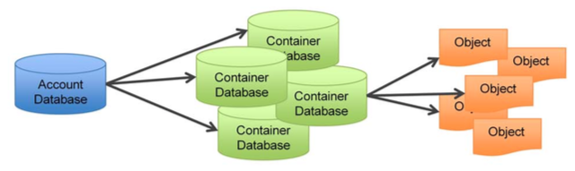
Swift’s Data Model and Architecture
Swift Data Model
OpenStack Swift allows users to store unstructured data objects with a canonical name containing three parts: Container Server
Account server
Object server

Slide 36
Swift’s Data Model and Architecture (contd.)
Container server:
a logical storage space.
Container Database: the container server’s primary job is to handles listing of objects. It doesn’t know where those objects are, only knows what objects are in which container. The listings are stored as SQlite database files, and replicated across the cluster similar to how objects are. Statistics are also tracked that include the total number of objects, and total storage usage for that container.

Slide 37
Swift’s Data Model and Architecture (contd.)
Account server:
determines right to containers. The Account Server is very similar to the Container Server, excepting that it is responsible for listings of containers rather than objects.
Account Database: a list of all Containers spread throughout the cluster that are usable by an Account. The account storage location is a uniquely named storage area that will contain the metadata (descriptive information) about the account itself, as well as the list of containers in the account.

Slide 38
Swift’s Data Model and Architecture (contd.)
Object server:
a very simple blob storage server that can store, retrieve and delete objects stored on local devices.
Objects are stored as binary files on the drive using a path that is made up in part of its associated partition (which we will discuss shortly) and the operation's timestamp. The timestamp is important as it allows the object server to store multiple versions of an object. The object’s metadata (standard and custom) is stored in the file’s extended attributes (xattrs) which means the data and metadata are stored together and copied as a single unit.

Slide 39
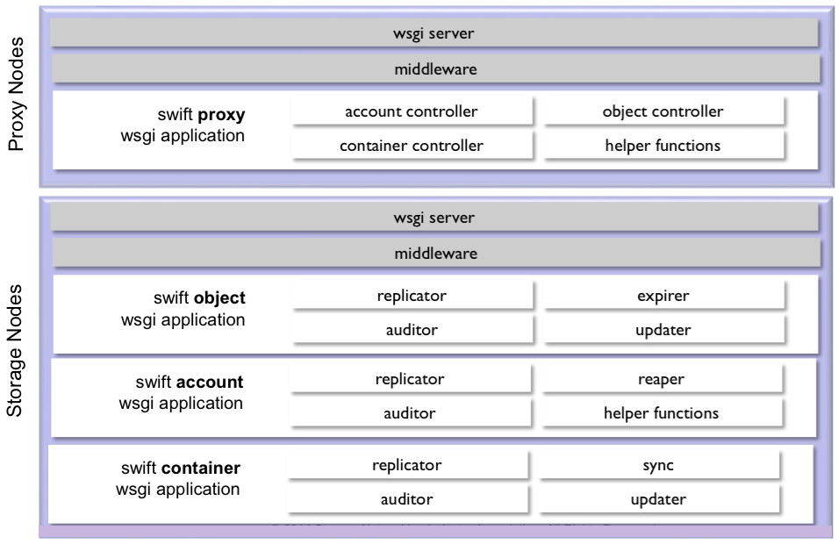
Swift’s Data Model and Architecture (contd.)

Slide 40
Swift’s Data Model and Architecture (contd.)
Consistency Service
A key aspect of Swift is that it acknowledges that failures happen and is built to work around them. When account, container or object server processes are running on node, it means that data is being stored there. That means consistency services will also be running on those nodes to ensure the integrity and availability of the data.
The two main consistency services :
Auditors
Replicators
There are also a number of specialized services that run in support of individual server process, e.g., the account reaper that runs where account server processes are running.

Slide 41
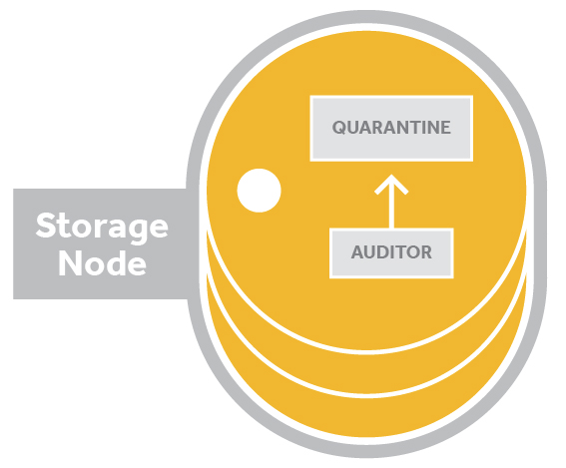
Swift’s Data Model and Architecture (contd.)
Auditors:
Auditors run in the background on every storage node in a Swift cluster and continually scan the disks to ensure that the data stored on disk has not suffered any bit-rot or file system corruption. There are account auditors, container auditors and object auditors which run to support their corresponding server process.
If an error is found, the auditor moves the corrupted object to a quarantine area.

Slide 42
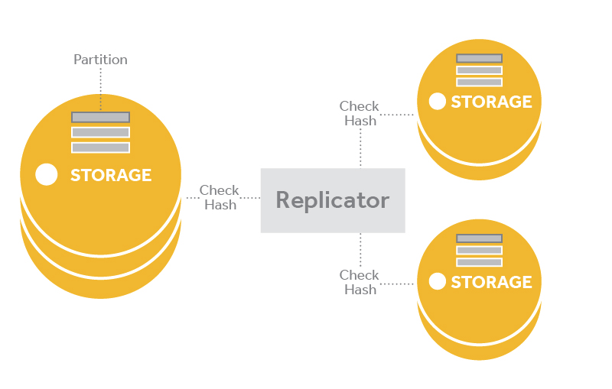
Swift’s Data Model and Architecture (contd.)
Replicators:
Ensure that enough copies of the most recent version of the data are stored where they should be in the cluster.
Handle object and container deletions.

Slide 43
Swift’s Data Model and Architecture (contd.) Replicators (Contd.)
Replication is designed to keep the system in a consistent state in the face of temporary error conditions like network outages or drive failures. The replication processes compare local data with each remote copy to ensure they all contain the latest version.
The replicator also handles object and container deletions. Object deletion starts by creating a zero-byte tombstone file that is the latest version of the object. This version is then replicated to the other nodes and the object is removed from the entire system.

Slide 44
Swift’s Data Model and Architecture (contd.)
Account Reaper:
When the account reaper locates an account marked as deleted, it begins stripping out all objects and containers associated with the account, ultimately removing the account record itself. With each pass it will continue to dismantle the account until it is emptied and removed.
To provide a buffer against error, the reaper can be configured with a delay so that it will wait for a specified period of time before it starts deleting data.

Slide 45
Swift’s Data Model and Architecture (contd.)
Container and Object Updaters:
Container updater: The container updater service runs to support accounts, it will update container listings in the accounts and account metadata (object count, container count, bytes used).
Object updater: The object updater runs to support containers, but as a redundant service. The object server process is the primary updater. Only if it fails with an update attempt will the object updater take over and then update object listing in the containers and container metadata (object count, bytes used).

Slide 46
Swift’s Data Model and Architecture (contd.)
Object expirer:
When an expiring object is written into the system, two things happen.
the expiry time is saved in the object metadata. This prevents the object server from serving objects when their expiry has passed, even if the object still exists on disk.
a reference to the expiring object is stored in the cluster in a special "dot account".
The object expirer periodically checks the expiry "dot account" for references to objects that have expired. For any object references found, the expiry process will issue a DELETE request, and the data is removed from the cluster.

Slide 47
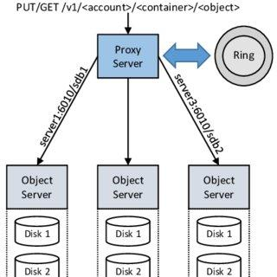
Swift’s Data Model and Architecture (contd.)
Components:
Proxy Server:
Handle all incoming API requests.
Will determine the storage node based on the URL of the objects.

Slide 48
Swift’s Data Model and Architecture (contd.) Proxy server(contd.)
Use a shared-nothing architecture and can be scaled as needed based on projected workloads.
A large number of failures are also handled in the Proxy Server. For example, if a server is unavailable for an object PUT, it will ask the ring for a handoff server and route there instead.
Also coordinates responses, and coordinates timestamps.
When objects are streamed to or from an object server, they are streamed directly through the proxy server to or from the user – the proxy server does not spool them.

Slide 49
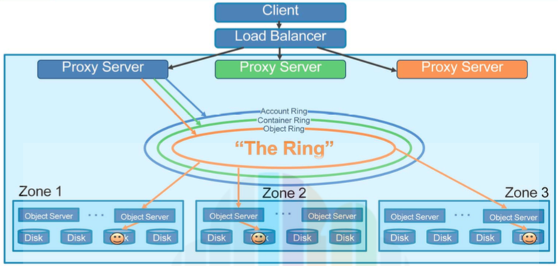
Swift’s Data Model and Architecture (contd.)
Zones:
It represent a location that can isolate data. This could be a drive, a server, a cabinet, a switch or even a datacenter.

Slide 50
Swift’s Data Model and Architecture (contd.) Zones(contd.)
Object storage allows configuring zones in order to isolate failure boundaries.
Each data replica resides in a separate zone.
A zone could be single drive or a grouping of a few drives.
An availability zone should be defines as distinct set of physical hardware whose failure would be isolated from other zones.
In a large deployment, availability zones may be defines as unique facilities in a large data center campus. In a single datacenter deployment, the availability zones may be different racks.
A cluster mostly happen has many zones.

Slide 51

Swift’s Data Model and Architecture (contd.)
Partitions:
A partition is a collection of stored data. This includes account databases, container databases and objects. Partition are core to the replication system. System replicators and object uploads or downloads operate on partitions. As the system scales up, its behavior continues to be predictable because the number of partitions is a fixed number.

Slide 52
Swift’s Data Model and Architecture (contd.) Partitions (contd.)
Num of partitions stored in one node = (num of replicas * total num of partitions) / num of nodes.
Choosing part_power:
Immutable once chosen.
At least 100 per disk.
Bigger part_power 🡪 bigger lookup table 🡪 more memory used (but lookup stay fast)

Slide 53
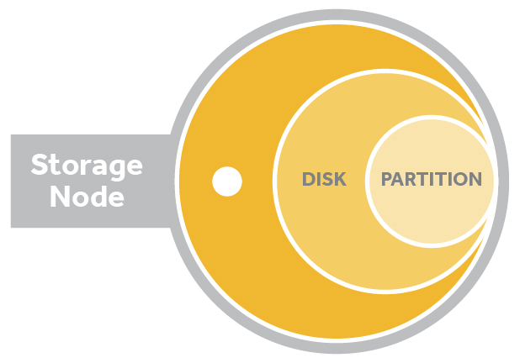
Swift’s Data Model and Architecture (contd.) Partitions (contd.)
The relation of storage node, disk and a partition is the below picture. Storage nodes have disks. Partitions are represented as directories on each disk
As a ring a built, the partitions are assigned to drives in the cluster. While the size and number of partitions does not change. The number of drives in the cluster does. The more drives in the cluster the fewer partitions per drive.

Slide 54
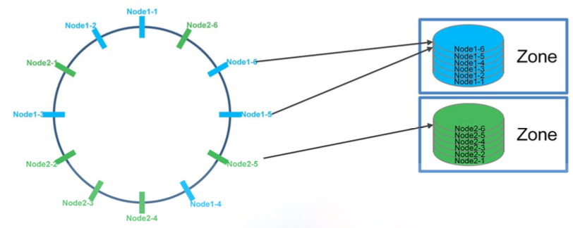
Swift’s Data Model and Architecture (contd.)
The Rings: A ring represents a mapping between the names of entities stored on disk and their physical location. There are separate rings for accounts, containers, and one object ring per storage policy. When other components need to perform any operation on an object, container, or account, they need to interact with the appropriate ring to determine its location in the cluster.

Slide 55
Swift’s Data Model and Architecture (contd.) The rings (contd.)
Mapping between entities stored and their physical locations on disk, an index.
The Ring maintains this mapping with zones, devices, partitions and replicas.
Each partition in the Ring is replicated three times across the cluster in different zones.
Rings are built through consistent hashing algorithm. The ring is used by the Proxy server and several background processes (like replication).
The ring is also responsible for determining which devices are used for handoff in failure scenarios.

Slide 56
Swift’s Data Model and Architecture (contd.) The rings (contd.)
For maintain the mapping it uses zones, devices, partitions and replicas. Each partition in the ring is replicated 3 times across the cluster by default and the locations for a partition are stored on the mapping maintained by the ring.
Each of the swift rings is a modified consistent hashing ring. This ring data structure includes the partition shift value which processes and services use to determine the hash of a storage location.
It has 2 internal data structures:
The device list
The device lookup table

Slide 57
Swift’s Data Model and Architecture (contd.) The rings (contd.)
The device list is populated with all the devices that have been added to a special ring building file. It is a list of devices in the cluster, a list of device ids indicating partition to device assignments. Each entry for a drive includes its ID number, zone, weight, IP, port and device name. The list of devices is known internally to the ring class as devs.
The device lookup table has one row replica and one column per partition in the cluster. This generates a table that is typically three rows by thousands of columns. During the building of a ring, Swift calculates the best drive to place each partition replica on using the drive weights and the unique placement algorithm. It then records that drive in the table.

Slide 58
SWIFT API
API stands for “Application programming interface”.
An API is the set of rules for interacting with a software system.
The swift API is the set of rules that specify the types of HTTP requests you are allowed to send to a Swift cluster, the types of failure and success responses you will get under what circumstances and the data those responses will contain.
Swift API implements REST with standard HTTP codes, verbs and authentication.
In other words, Swift uses a RESTful HTTP API.

Slide 59
SWIFT API
Representational State Transfer (REST) -
A REST API is an architectural style for an application program interface (API) that uses HTTP requests to access and use data.
It is a set of rules that is designed to take advantage of existing protocols.
REST can be used over almost any protocol but it usually takes advantage of HTTP.
Swift exposes every container and object as a unique URL and maps HTTP methods like PUT,GET, DELETE etc. to the common data management operations.
Swift makes use of most of the HTTP verbs.

Slide 60
SWIFT API
A foundational premise of Swift is that requests are made via HTTP using a RESTful API. All requests sent to Swift are made up of at least three parts:
1. HTTP verb
2. Authentication information
3. Storage URL
The HTTP verb provides the action of the request.
The authentication information allows the request to be fulfilled.
The storage URL is basically has two purposes. One is, it contains the cluster address where the request should be sent and the storage location inside the cluster where the requested action should take place.

Slide 61
SWIFT API HTTP verbs
HTTP verbs Swift uses most frequently –
GET – downloads objects, retrieves data, lists the contents of containers or account
PUT – upload objects, stores data, creates containers, overwrite metadata headers
POST – creates containers if they don’t exist, updates metadata, overwrites metadata
DELETE – deletes objects and containers
HEAD – retrieves only the header information of the swift account, container or object.

Slide 62
SWIFT API HTTP verbs: Process for a PUT request
The HTTP PUT method is used to save data to a Swift cluster.
Firstly, the swift user connects with the proxy server. Then sends a PUT request and the data which the user wants to save or upload in the swift cluster.
Secondly, the proxy server connects with the ring and finds the Object servers/Nodes with the help of the ring and the data is stored in the disk of the server as an object.
As for the Ring architecture and replication process, the data which is just stored in the disk of the node will be replicated to other nodes which are configured in the ring-builder files.
If the replication number in the ring-builder file is 3, then it means the object will be stored in three nodes or will be replicated to three nodes.
For the PUT request, the user must be authorized.

Slide 63
SWIFT API HTTP verbs: Process for a GET request
The HTTP GET method is used to retrieve data.
Firstly, the swift user connects with proxy server. Then sends a GET request along with the URL of the storage location of the data which the user wants to retrieve.
Secondly, the proxy server connects with the ring and then, successfully present the GET request to the object server.
After receiving the GET request from the user, the object server sends the data to the user.
As by default, same data is replicated in three different nodes, the GET request is responded by one object server. If an object server is not available, then the GET request gets pass along to the next object server.

Slide 64
SWIFT API HTTP verbs: Process for a DELETE request
The HTTP DELETE method is used to remove data.
Here also, the swift user connects with the proxy server first. Then sends a DELETE request along with the URL of the storage location of the data which the user wants to remove.
And then, the proxy server connects with the ring and finds the Object servers/Nodes with the help of the ring and the URL.
Then, the DELETE request is presented to the object servers.
The DELETE method requests the server to delete the information at the given URL.
After that, the object server will delete the data from the disk.
For the DELETE request, the user must be authorized.

Slide 65
SWIFT API HTTP verbs: Process for a HEAD request
The HTTP HEAD method is used to retrieve metadata.
It works almost like the HTTP GET method request. But there is a difference.
The GET method retrieves the whole data whereas, the HEAD method only retrieves the headers, not the actual data.
It functions like a GET request that disappears the data.
It can be useful when the data is very large and we might want to take action based on just the headers.
In all of the requests, there is some authentication information and storage URL along with the HTTP methods.
Without the authentication, the requests can not be fulfilled.
And without the storage URL, the cluster and the storage location can not be found. Therefore, the requests can not be fulfilled.

Slide 66
SWIFT API Response codes
Response codes –
1. 1xx (Informational)
Example: 100 Continue
1. 2xx (Success)
Example: 200 OK
2. 3xx (Redirection)
Example: 300 Multiple choices, 301 Moved Permanently
3. 4xx (Client error)
Example: 401 Unauthorized, 400 Bad Request
4. 5xx (Server error)
Example: 500 Internal Server Error

Slide 67
SWIFT API Authentication
Authentication is done by comparing the information you provide with the information on the authentication server Swift uses.
Two ways to handle authentication -
1. Passing the authentication credentials in with the request each time.
2. Passing in an authentication token that you obtain by making a special authentication request before making any storage requests.
After the installation and configuration of the cluster, you will need to integrate it with authentication and authorization system.
Swift uses a token-based protocol for both authentication and authorization.
To authenticate, the user provides credential information such as a username and password over HTTPS/HTTP, and if the credentials are valid, the user receives a token that can be sent in with future requests as verification.

Slide 68
SWIFT API Authentication
Swift allows administrators to plug one or more auth services into its framework.
Swift comes with two types of auth middleware.
Keystone Auth
TempAuth
Keystone Auth system is better for production environments.
TempAuth is not suitable for production use because it deliberately compromises security for the sake of convenience, But it might be acceptable for testing Swift.

Slide 69
SWIFT API Authentication
All authentication requests are directed to an auth URL.
A successful authentication is one where the user provides his/her information to the auth URL for their swift cluster and gets an authentication token (auth token) and storage URL in return that allows the user to access the storage location of his primary Swift account.
Three working function of Authentication –
Authentication Request – The Swift proxy server process receives the user’s credential information and passes it to the Swift auth middleware.
Authentication Handling – Each configured auth middleware component will check the request to determine whether its own auth system can verify user credentials.
Authentication Response – Once the request is checked, a response is returned to the proxy server address.

Slide 70
SWIFT API Authentication
Communication Tools –
A command line interface (CLI) is all you need to perform simple operations on a Swift cluster.
There are some low level and high level CLIs available. We are going to explain two specific CLIs we can use as a communication tool –
1. cURL
2. Swift
Both of these allow a user to send requests, one line at a time, to a Swift cluster.

Slide 71
SWIFT API Authentication
Using cURL -
Client for URLs (cURL) is a popular command-line tool for transferring data to and from a server using the URL syntax. We are going to see the structure of a cURL command to make a GET request –
curl –X GET […] <Storage-URL> <object.ext>: Here, curl is the command, -X option is used to provide HTTP verb, authentication information is represented by […], then the storage URL is required and lastly, the data and metadata which is optional.
The storage URL for Shahriar’s swift account might be http://swift.example.com/v1/AUTH_shahriar
Then the GET request would look like this –
curl –X GET […] http://swift.example.com/v1/AUTH_shahriar <object.ext>

Slide 72
SWIFT API Authentication
Using Swift –
The Swift CLI is a part of the python-swiftclient package and can be installed on any computer running Python 2.6 or 2.7.
Just as the cURL CLI uses curl command, the Swift CLI uses the swift command.
One reason the swift command is popular because it provides users with human friendly verbs to use when communicating with a cluster.
The swift command requires the username, password and authentication URL to be passed in with each request.
HTTP GET request using Swift CLI command structure-
swift list […] http://swift.example.com/v1/AUTH_shahriar: Here swift is the command, list is the request for information, […] is the authentication information, and lastly the storage location of the user shahriar.
swift download […] http://swift.example.com/v1/AUTH_shahriar/myContainer myObject.txt

Slide 73
SWIFT API Authentication
Although the command-line interfaces are fine for simple operations, many users will need more sophisticated client applications, with customization and integration.
Application developers can construct HTTP requests and parse HTTP responses using their programming language’s HTTP library.
The may choose to use open source Swift libraries to abstract away the details of the HTTP interface.
Open source client libraries for Swift are available for most modern programming languages, including:
Python
Ruby
Java
PHP
C#

Slide 74
SWIFT API Storage URL
The storage URL has two roles to play.
It is How the request gets to the cluster.
It indicates where in the cluster the request is supposed to take place.
The format for a storage URL for an object in a Swift cluster might look like this:
http://swift.example.com/v1/account/container/object
“swift.example.com/v1” is the cluster location.
“/account/container/object” is the storage location.
The storage location might be one of the three formats, depending on which resource you are trying to reach with your request –
Account: /account
Container: /account/container
Object: /account/container/object

Slide 75
Intesur Ahmed – 18101685 Galib Abdunnoor – 20141037 Priata Nowshin – 20141035 Shahriar Rumi Dipto – 20141036

Slide 76
References –
Book - OpenStack Swift: Using, Administering, and Developing for Swift Object Storage Book by Joe Arnold
Slide –https://docs.google.com/presentation/d/1zFwSiN6GxCoCrmxgW5I7Fy42SLeeJfjU/edit#slide=id.g810f9195d0_0_0
https://youtu.be/Ly2aerlXcn4
https://www.alyseo.com/wp-content/uploads/2014/12/SB-Coraid_SoftwareDefinedStorage.pdf
https://www.redhat.com/en/topics/data-storage/software-defined-storage
https://www.swiftstack.com/product/open-source/openstack-swift
https://insujang.github.io/2020-08-30/introduction-to-ceph/
https://zach-gollwitzer.medium.com/file-nas-vs-block-san-vs-object-cloud-storage-c021d81fa3ff
https://developer.rackspace.com/docs/cloud-files/v1/
https://docs.openstack.org/swift/latest/admin/objectstorage-components.html
https://www.swiftstack.com/docs/introduction/openstack_swift.html#container-and-object-updaters
https://docs.openstack.org/swift/latest/overview_architecture.html
https://searchapparchitecture.techtarget.com/definition/RESTful-API
https://docs.openstack.org/api-ref/object-store/?expanded=list-activated-capabilities-detail,create-container-detail,create-or-replace-object-detail#
https://docs.openstack.org/swift/latest/api/object_api_v1_overview.html
https://www.swiftstack.com/docs/introduction/openstack_swift.html

